Slide 1
Discrete Mathematics
Instructor: Anam Ashraf

Slide 2
Proposition
A declarative sentence that is either true or false, but not both
  Washington, D.C., is the capital of USA
  California is adjacent to New York
  1+1=2
  2+2=5
  What time is it?

Slide 3
Logical operators
Negation operator
Conjunction (and, ^)
Disjunction (or v )
Conditional statement →
Biconditional statement ←→
Exclusive Or

Slide 4
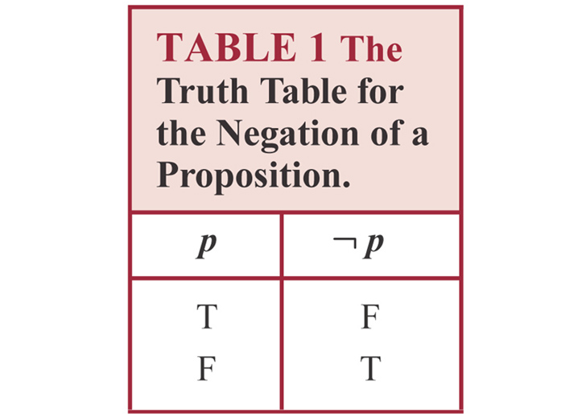
Negation

Slide 5
Example
“Today is Friday”
  It is not the case that today is Friday
  Today is not Friday
At least 10 inches of rain fell today in Islamabad.
  It is not the case that at least 10 inches of rain fell today in Islamabad.
  Less than 10 inches of rain fell today in Islamabad.

Slide 6
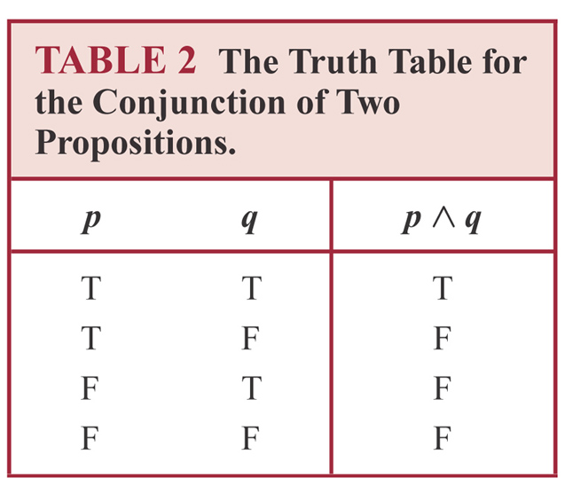
Conjunction
Conjunction: p ^ q is true when both p and q are true. False otherwise

Slide 7
Example
p: “Today is Friday”,
q: “It is raining today”
p˄q “Today is Friday and it is raining today”
  true: on rainy Fridays
  false otherwise:
    Any day that is not a Friday
    Fridays when it does not rain

Slide 8

Disjunction
Disjunction: p v q is false when both p and q are false. True otherwise

Slide 9
Example
p ˅ q: “Today is Friday or it is raining today”
  True:
    Today is Friday
    It is raining today
    It is a rainy Friday
  False
    Today is not Friday and it does not rain

Slide 10
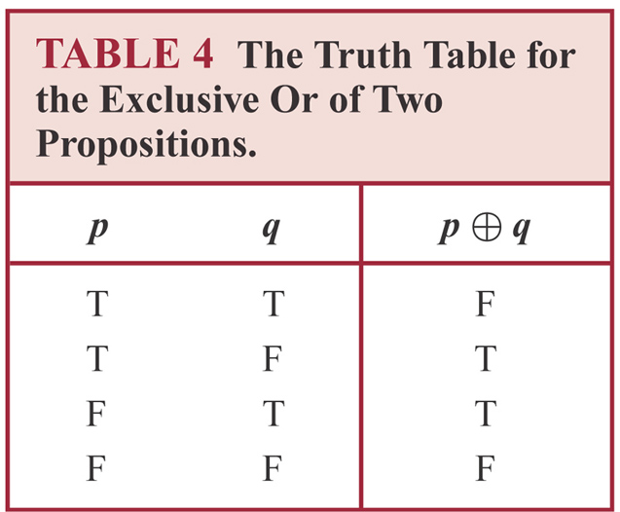

Exclusive or
Exclusive Or is true when exactly one
of p, q is true. False otherwise

Slide 11
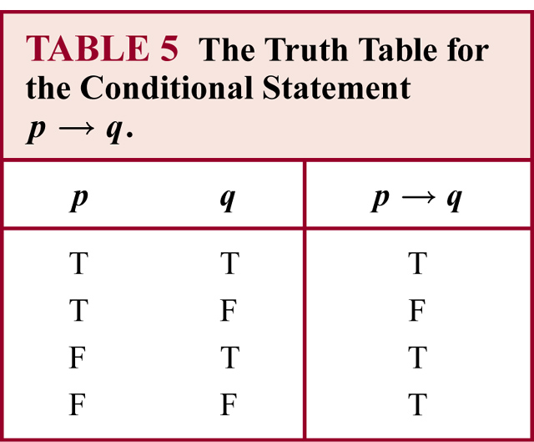
Conditional statement
Conditional Statement:
p is called the premise (or antecedent)
q is called the conclusion (or consequent)
p→ q is false when p is true and q is false. True otherwise

Slide 12
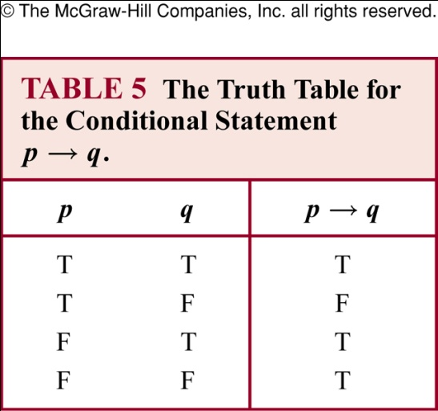
Conditional statement p→q
Also called an implication
if p, then q | p implies q
if p, q | p only if q
p is sufficient for q | a sufficient condition for q is p
q if p | q whenever p
q when p | q is necessary for p
a necessary condition for p is q q unless ┐ p | q follows from p
Conditional Statement: p→q is false when p is true and q is false. True otherwise
Example
p: you go, q: I go. p→q means “If you go, then I go” is equivalent to p only if q “You go only if I go” (not the same as “I go only if you go” which is q only if p)

Slide 13
p→q
p only if q:
  p cannot be true when q is not true
  The statement is false if p is true but q is false
  When p is false, q may be either true or false
  Not to use “q only if p” to express p→q
q unless ┐ p
  If ┐ p is false, then q must be true
  The statement is false when p is true but q is false, but the statement is true otherwise

Slide 14
Example
If Maria learns discrete mathematics, then she will find a good job
  Maria will find a good job when she learns discrete mathematics (q when p)
  For Maria to get a good job, it is sufficient for her to learn discrete mathematics (sufficient condition for q is p)
  Maria will find a good job unless she does not learn discrete mathematics (q unless not p)

Slide 15
Common mistake for p→q
Correct: p only, if q
Mistake to think “q only if p”

Slide 16
Example
“If today is Friday, then 2+3=6”
  The statement is true every day except Friday even though 2+3=6 is false

Slide 17
Converse, contrapositive and inverse
For conditional statement p→ q
  Converse: q→ p
  Contrapositive: ┐q → ┐ p
  Inverse: ┐p → ┐ q
Contrapositive and conditional statements are equivalent

Slide 18
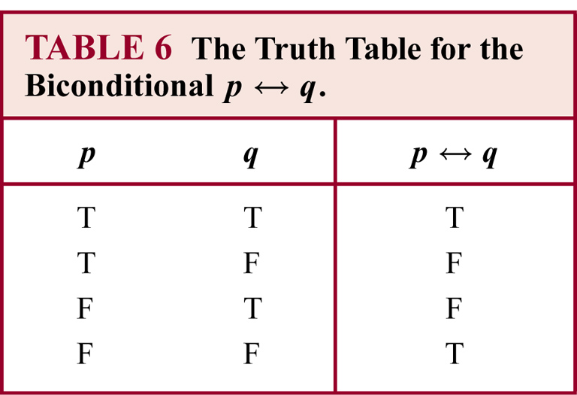
Biconditional statement
Biconditional Statement: “p if and only if q”
p ←→ q is true when p, q have the same truth value. False otherwise
Also known as bi-implications

Slide 19
Example
P: “you can take the flight”, q: “you buy a ticket”
P ←→ q: “You can take the flight if and only if you buy a ticket”
  This statement is true
    If you buy a ticket and take the flight
    If you do not buy a ticket and you cannot take the flight

Slide 20
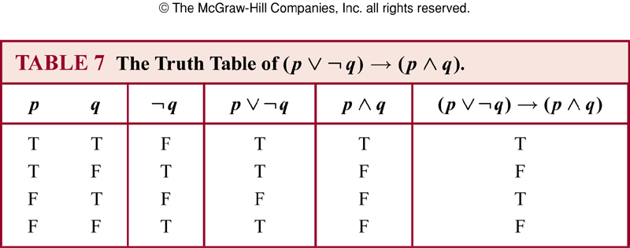
Truth table of compound propositions

Slide 21
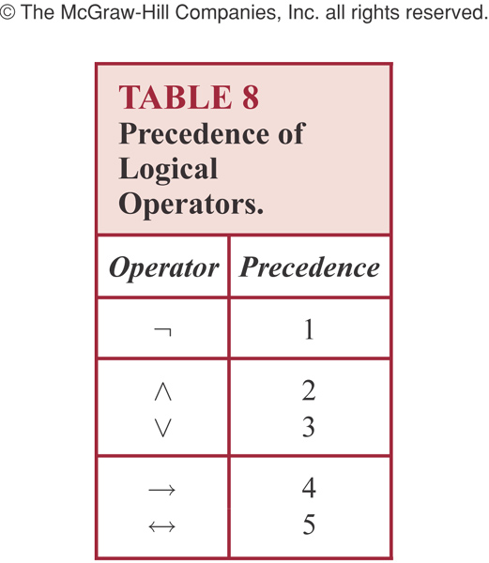
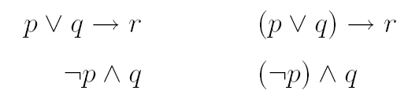
Precedence of logic operators

Slide 22
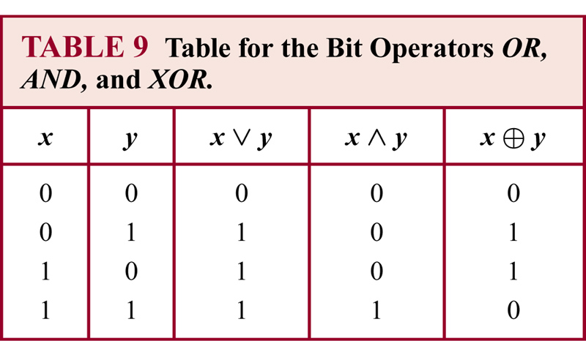
Bit operations
Notes:
Both true or false….false

Slide 23
1.2 Translating English to logical expressions
Why?
English is often ambiguous and translating sentences into compound propositions removes the ambiguity
Using logical expressions, we can analyze them and determine their truth values
We can use rules of inferences to reason about them

Slide 24
Example
“ You can access the internet from campus only if you are a computer science major or you are not a freshman.
p : “You can access the internet from campus”
q : “You are a computer science major”
r : “You are freshmen”
p → ( q v ┐r )

Slide 25
System specification
Translating sentences in natural language into logical expressions is an essential part of specifying both hardware and software systems.
Consistency of system specification.
Example: Express the specification “The automated reply cannot be sent when the file system is full”.

Slide 26

Example
Let p denote “The automated reply can be sent”
Let q denote “The file system is full”
The logical expression for the sentence “The automated reply cannot be sent when the file system is full” is

Slide 27
Example
Determine whether these system specifications are consistent:
1. The diagnostic message is stored in the buffer or it is retransmitted.
2. The diagnostic message is not stored in the buffer.
3. If the diagnostic message is stored in the buffer, then it is retransmitted.

Slide 28
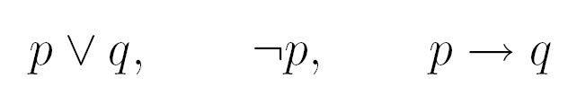
Example
Let p denote “The diagnostic message is stored in the buffer”
Let q denote “The diagnostic message is retransmitted”
The three specifications are

Slide 29
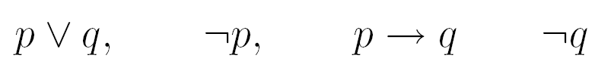
Example
If we add one more requirement “The diagnostic message is not retransmitted”
The new specifications now are
This is inconsistent! No truth values of p and q will make all the above statements true

Slide 30
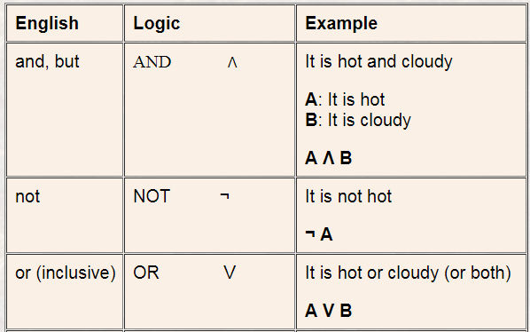
Examples

Slide 31

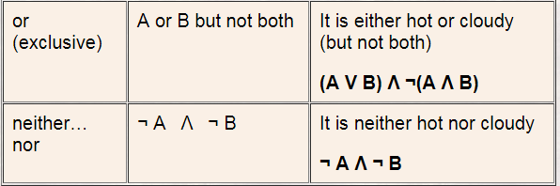
Examples (cont..)

Slide 32
PRACTICE QUESTION
Q) Represent as propositional expressions the statements:
John is healthy and wealthy but not wise
John is not wealthy but he is healthy and wise
John is neither healthy nor wealthy nor wise
Q) translate it into a propositional form and write down its truth table.

